Slide 1
GLOBAL ELECTRONICS
DATA ANALYSIS REPORT

Slide 2
Data Cleaning and Preparation
Steps Taken:
Identified Missing Values:
Conducted an analysis of missing values across all tables and handled them appropriately through imputation or removal.
Converted Data Types:
Ensured that all data types were suitable for analysis, converting dates to the DATE type and numeric values to FLOAT or INT.
Merged Datasets:
Integrated the datasets using common keys to create a comprehensive dataset for analysis.

Slide 3
Exploratory Data Analysis (EDA)
Exploratory Data Analysis (EDA) is a crucial step in the data analysis process, involving various techniques to understand, visualize, and summarize the main characteristics of a dataset. The primary goal is to discover patterns, spot anomalies, test hypotheses, and check assumptions with the help of summary statistics and graphical representations. Here’s a structured approach to the EDA process:

Slide 4
Exploratory Data Analysis (EDA)
Data Collection and Loading
Data Cleaning
Data Profiling
Univariate Analysis
Bivariate Analysis
Multivariate Analysis
Data Visualization
Feature Engineering
Hypothesis Testing

Slide 5
Analysis Steps
Customer Analysis
Demographic Distribution:
The majority of customers are located in urban areas.
There is a higher concentration of customers in certain states and countries.
Purchase Patterns:
High-value customers tend to purchase a diverse range of products.
Purchase frequency varies significantly among customers.
Customer Segmentation:
The majority of customers fall into the 'Middle-aged' category.
'Young' customers have a higher average order value compared to other age groups.

Slide 6
Sales Analysis
Overall Sales Performance:
Sales have shown an upward trend over the past year.
Seasonal variations are evident, with peaks during certain months.
Sales by Product:
Certain products consistently generate higher revenue.
A small number of products account for the majority of sales.
Sales by Store:
Some stores significantly outperform others in terms of sales.
Store location and size are contributing factors to sales performance.
Sales by Currency:
Sales in USD are predominantly higher, followed by sales in EUR and GBP.
Currency exchange rates impact overall revenue.

Slide 7
Product Analysis
Product Popularity:
Certain products are significantly more popular than others.
Popular products tend to have higher sales volumes.
Profitability Analysis:
High-profit-margin products are primarily in the electronics category.
Some products have very low profit margins, indicating potential areas for cost reduction.
Category Analysis:
Certain categories, such as electronics and home appliances, generate higher revenues.
Categories with lower revenue might need targeted marketing or re-evaluation.

Slide 8
Store Analysis
Store Performance:
Identify top-performing stores based on total sales and sales per square meter.
Analyze sales trends over time to determine peak seasons and growth patterns.
Geographical Analysis:
Identify high-performing regions and cities.
Correlate sales performance with regional demographics and economic indicators.

Slide 9
Recommendations
Customer Insights:
Tailor marketing strategies and segmentation based on customer demographics and purchase patterns.
Implement tailored marketing strategies based on customer demographics and purchase patterns.
Focus on engaging 'Young' customers who have higher average order values.

Slide 10
Sales Optimization
Focus on high-revenue products and stores; consider currency impact on pricing.
Analyze product performance and optimize inventory for high-revenue and high-margin products.
Assess store performance to identify top-performing locations and replicate successful strategies.

Slide 11
Product Development
Invest in high-margin and high-demand products.
Prioritize the development and promotion of high-demand and high-margin products.
Explore opportunities to reduce costs for low-margin products.

Slide 12
Store Strategy and International Pricing
Optimize or expand stores based on performance and geographical insights.
Consider expanding top-performing stores or optimizing operations at underperforming locations.
Utilize geographical data to identify potential areas for new store openings.
Take into account currency exchange rates when setting international prices.
Monitor the impact of currency fluctuations on overall revenue.

Slide 13
Pitching Some Ideas
Customer-Centric Marketing Strategies
Insight:
Majority of customers fall into the 'Middle-aged' category.
'Young' customers have higher average order values.
Urban areas have a higher concentration of customers.
Pitch:
Targeted Campaigns: Develop age-specific marketing campaigns to address the needs and preferences of each age group. For instance, focus on tech-savvy products for young customers and offer promotions on household electronics for middle-aged customers.
Urban Focus: Concentrate marketing efforts in urban areas where there is a higher customer density, using geo-targeted advertisements and promotions.

Slide 14
Optimizing Inventory and Product Offerings
Insight:
High-revenue products and categories (e.g., electronics and home appliances).
Low-margin products identified.
Pitch:
Inventory Management: Use data-driven insights to ensure that high-revenue products are always in stock. Implement a dynamic inventory management system that prioritizes these products.
Cost Reduction: Analyze and optimize the supply chain for low-margin products to reduce costs and improve profitability. This may involve negotiating better terms with suppliers or finding alternative sources.

Slide 15
Enhancing Store Performance
Insight:
Significant performance variations among stores.
Geographic distribution of high-performing stores.
Pitch:
Store Optimization: Evaluate and replicate the successful strategies of top-performing stores across other locations. This includes store layout, staffing, and promotional tactics.
Expansion Strategy: Use geographic data to identify potential new store locations in underserved but promising areas, based on demographic and sales data.

Slide 16
Leveraging Product Popularity for Growth
Insight:
Certain products have significantly higher popularity and sales volumes.
Pitch:
Promotional Focus: Develop promotional campaigns that highlight popular products to drive sales. Consider bundling these products with complementary items to increase average order value.
New Product Development: Use insights from popular products to guide the development of new products. Focus on features and categories that have shown strong customer interest.

Slide 17
Dynamic Pricing and International Strategy
Insight:
Impact of currency exchange rates on overall revenue.
Sales in different currencies (USD, EUR, GBP).
Pitch:
Dynamic Pricing: Implement a dynamic pricing strategy that adjusts prices based on real-time currency exchange rates. This will help in maximizing revenue from international sales.
Localized Marketing: Develop localized marketing and pricing strategies for international markets. Tailor product offerings and pricing based on local preferences and economic conditions.

Slide 18
Customer Loyalty and Engagement Programs
Insight:
High-value customers tend to purchase a diverse range of products.
Pitch:
Loyalty Programs: Create a loyalty program that rewards repeat customers with exclusive offers and discounts. Use data on preferred products to personalize these rewards.
Engagement Strategies: Develop engagement strategies such as personalized recommendations, follow-up emails after purchases, and special events for loyal customers.

Slide 19
Data-Driven Decision Making
Insight:
Comprehensive data analysis providing valuable insights.
Pitch:
BI and Analytics: Invest in business intelligence and analytics tools to continuously monitor and analyze sales, customer behaviour, and inventory. Encourage a data-driven culture within the organization to make informed decisions.
Training and Development: Provide training for staff on how to interpret and use data insights to improve their operations, whether in marketing, inventory management, or customer service.

Slide 20
Conclusion
Presenting these insights and recommendations will help to enhance marketing strategies, optimize operations, and drive growth.
Emphasize the actionable nature of the insights and the potential for significant ROI by implementing data-driven strategies.
This approach will not only improve customer satisfaction but also lead to better financial performance and competitive advantage.

Slide 21
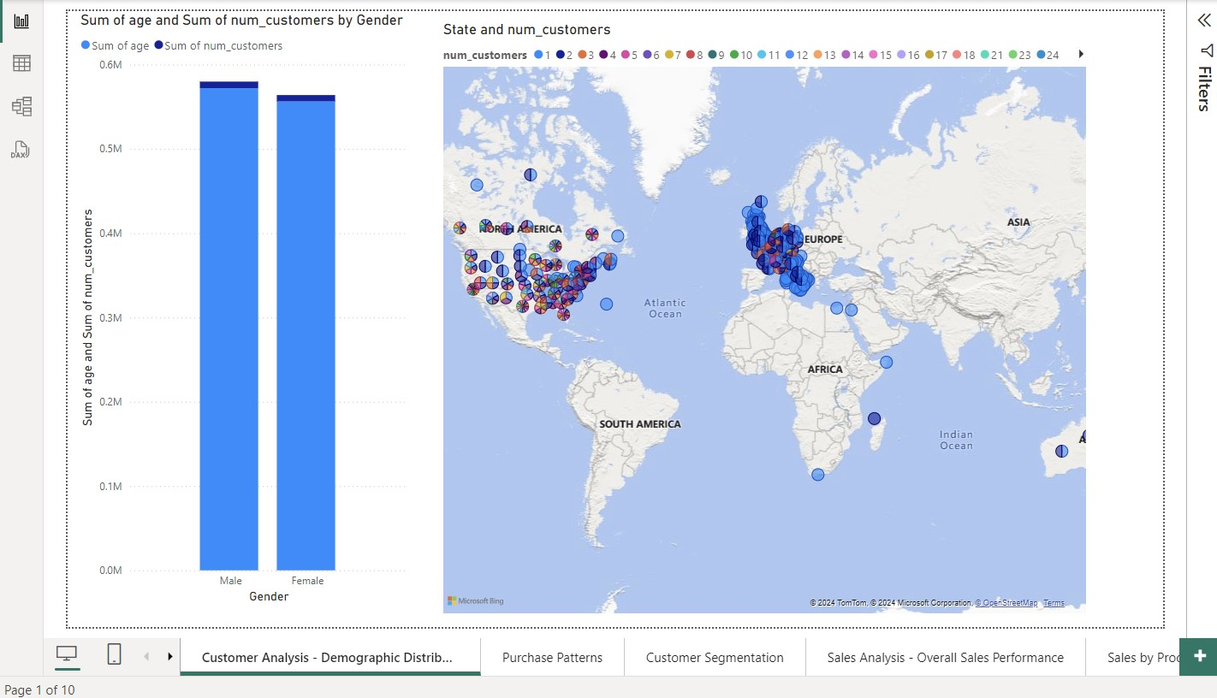
POWER BI DASHBOARDS

Slide 22
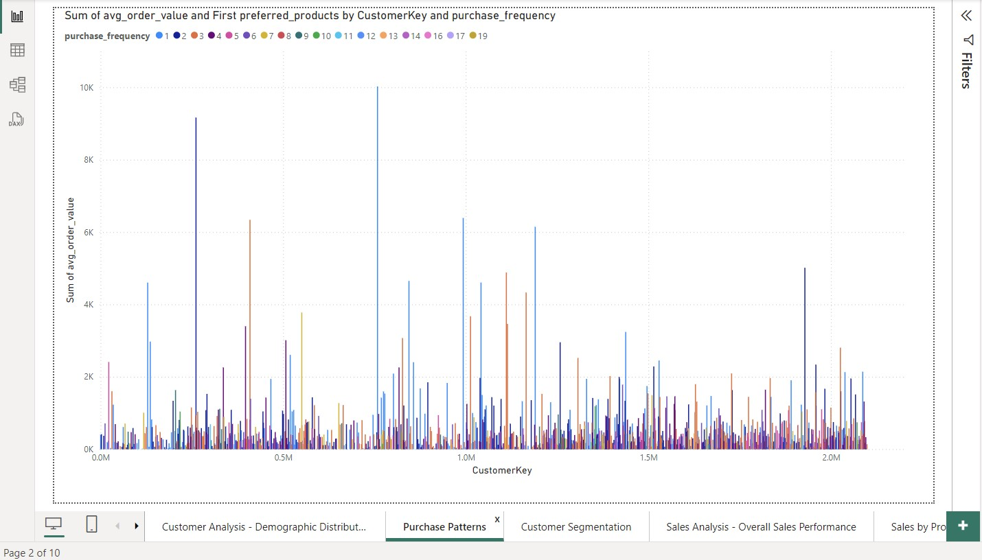
POWER BI DASHBOARDS

Slide 23
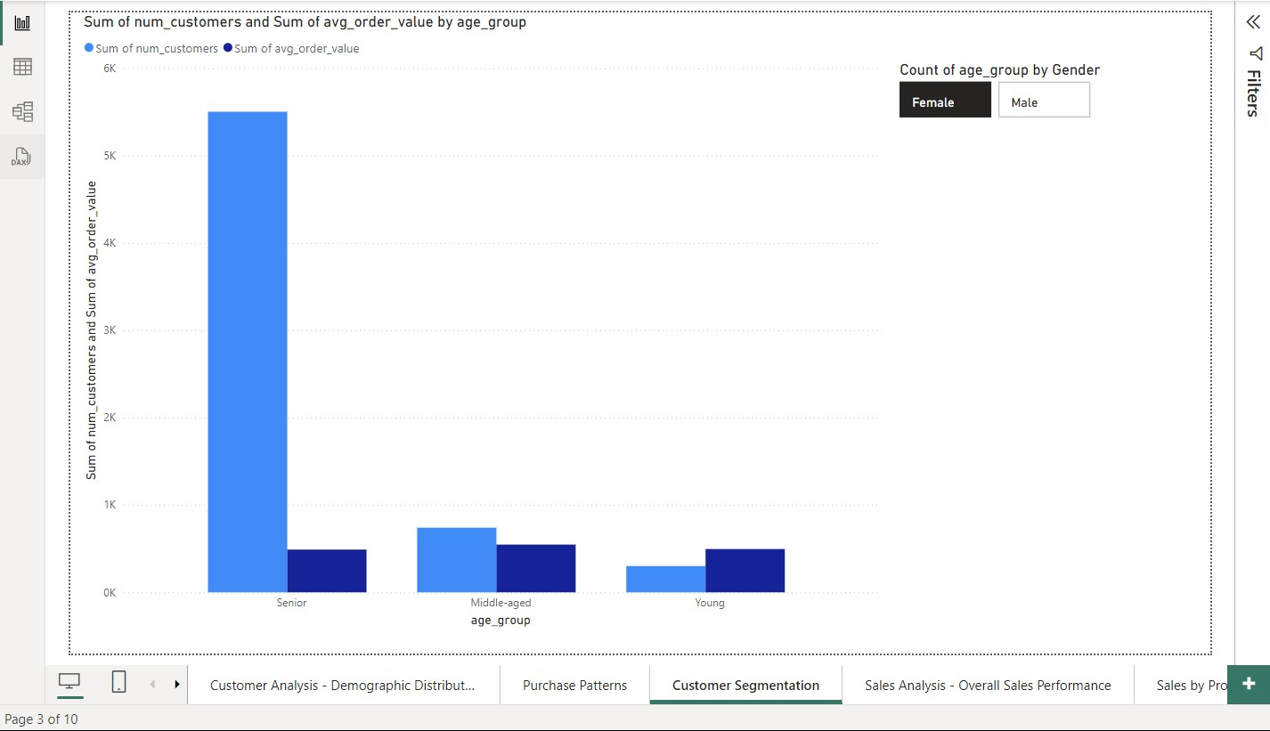
POWER BI DASHBOARDS

Slide 24
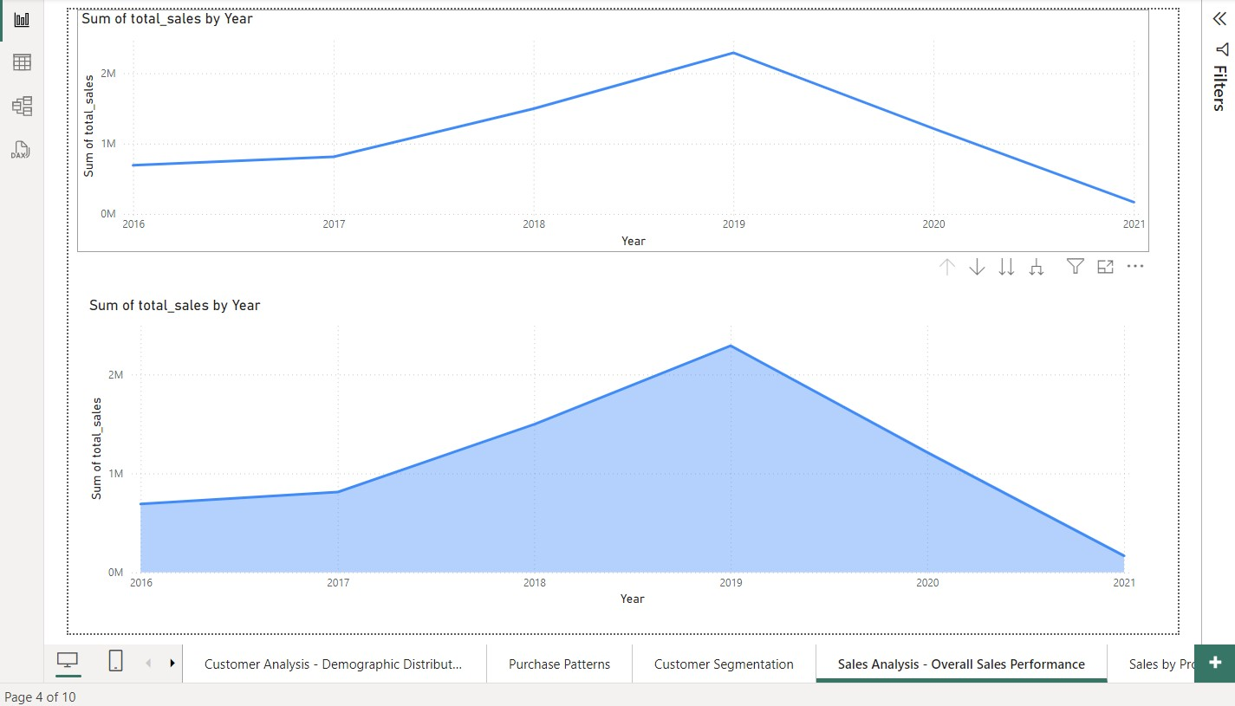
POWER BI DASHBOARDS

Slide 25
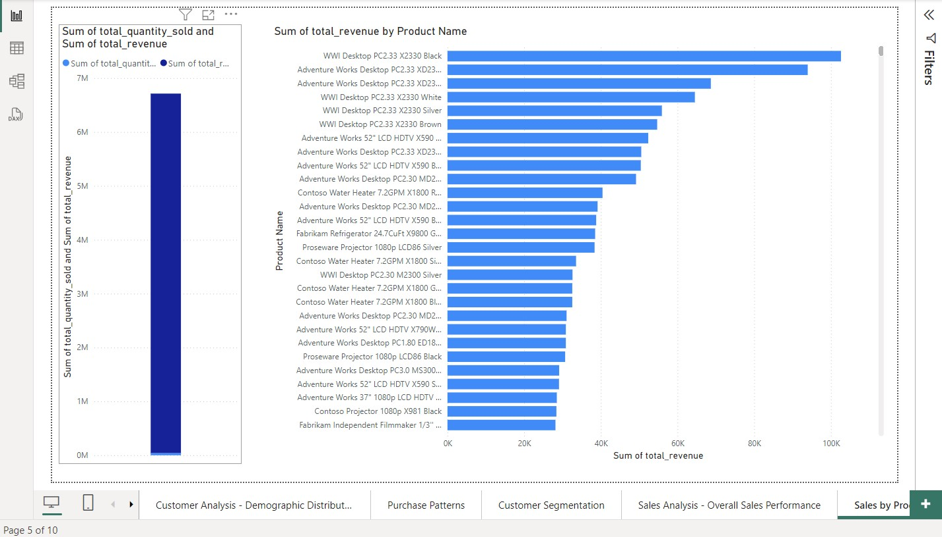
POWER BI DASHBOARDS

Slide 26
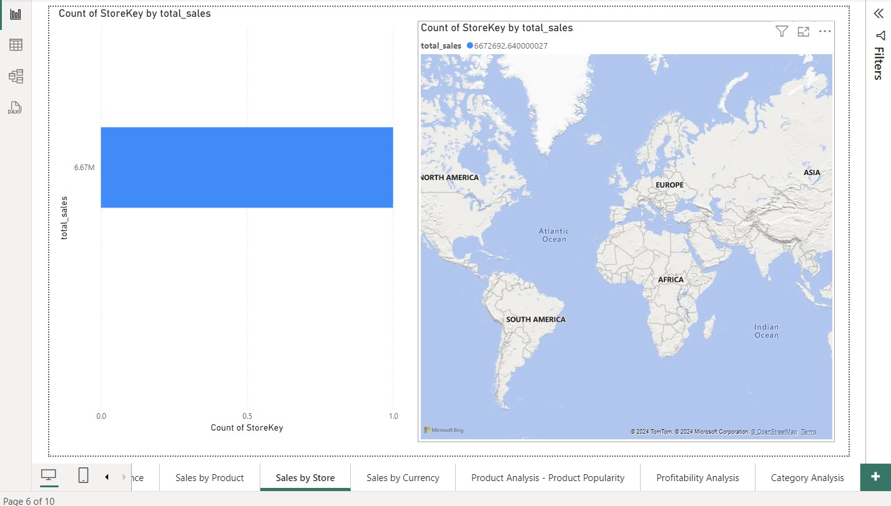
POWER BI DASHBOARDS

Slide 27
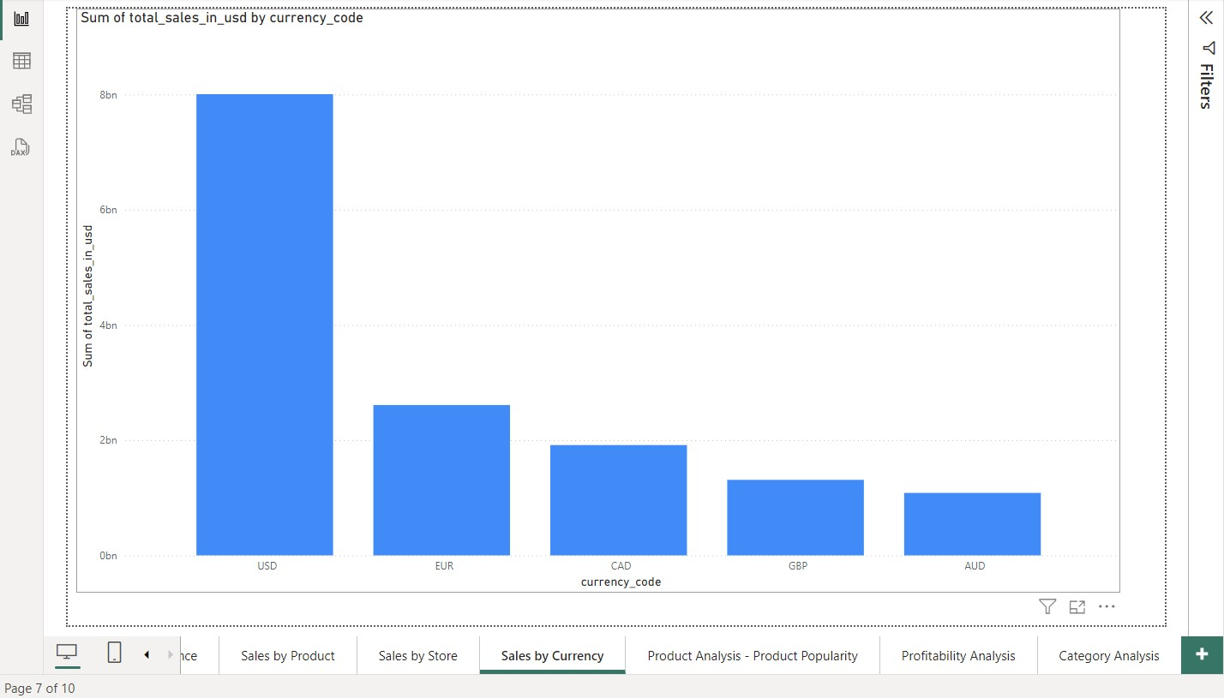
POWER BI DASHBOARDS

Slide 28
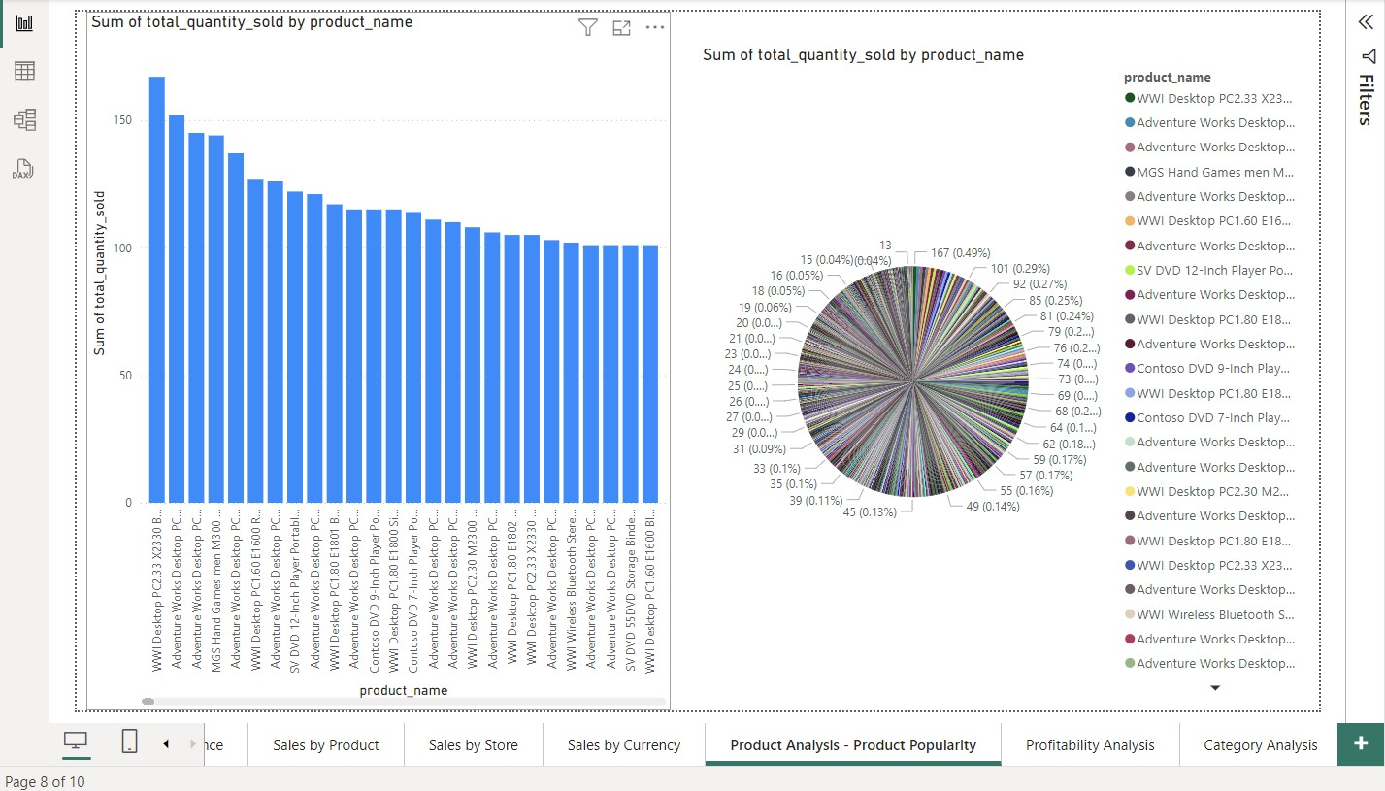
POWER BI DASHBOARDS

Slide 29
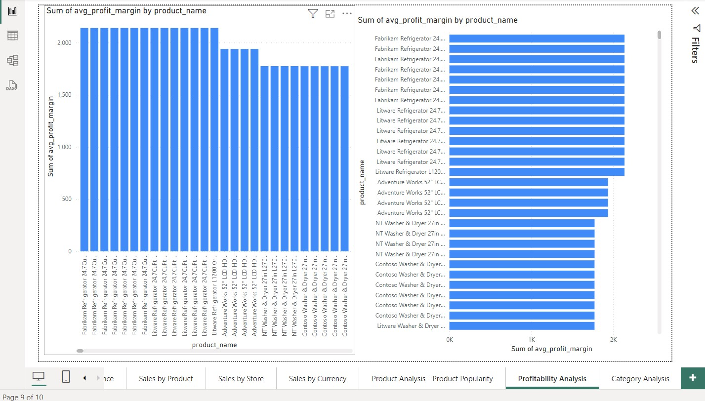
POWER BI DASHBOARDS

Slide 30
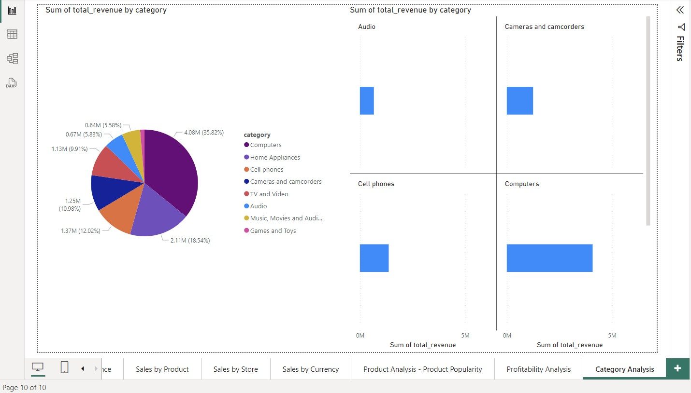
POWER BI DASHBOARDS

